Slide 1
ENG4118/5326 - Robotics 4/M Sensors, Actuators and Image capture, processing and analysis
Lecture 4
Kevin Worrall

Slide 2
Sensor Connection

Slide 3
Sensor Connection
Need to be aware that your sensor needs to connect to something
Logging system
Communication bus
Microcontroller
Analog to digital convertor
…
Expectation is that this connection will be perfect
What the sensor reads is what the system that is connected to it reads
…but…
You are introducing additional sources of everything we have discussed

Slide 4
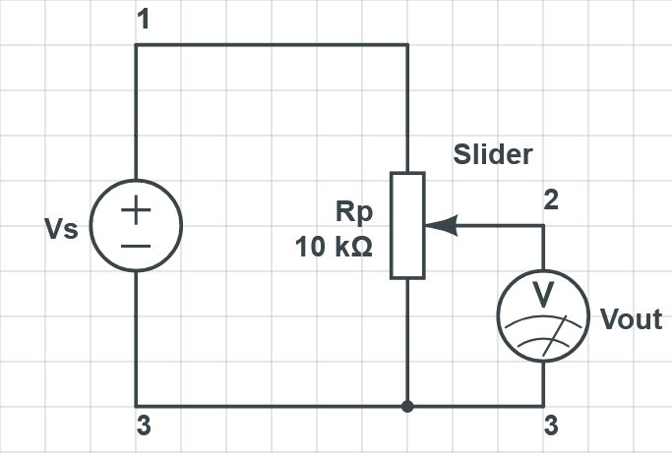
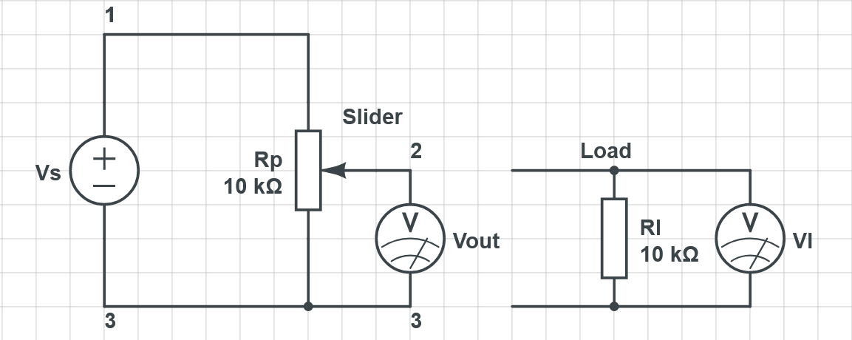
Sensor Connection
Most common example is a sensor that outputs a voltage…
More on this particular example later but there is an instant change…
Your output is no longer a relationship between Vs and Vout (as you will find in a data sheet) but actually Vs and VI
But…

Slide 5
Sensor Connection
Voltage and current measurements need an interface
Impedance
Noise
Pins, wires, connectors, cable lengths… can all impact
Is your analogue interface suitable?
does your Analogue to Digital converter have a good resolution?
But what about digital interfaces?
Timing – is your sensor the only one on the bus?
Can you detect and react within a suitable timeframe?
What is the actual speed of the network and the actual time stamp?
If you have a 24-bit output from a signal but a 16-bit processor – how do you ensure that you don’t lose information?

Slide 6
Sensor Modelling

Slide 7

Sensor Modelling
It can help to consider a single sensor as a system
Input
Disturbances
Desired
Output
Fundamentally a general sensor equation can be given as:
$$y=f\left(a,x\right)+c$$
Where y is the output, f is a sensor function, x is the sensor input, a represents internal parameters, c is a constant

Slide 8
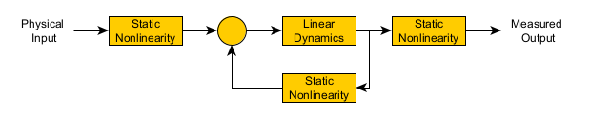
Sensor Modelling
There are general models of sensors
Hammerstien-Wiener feedback model is one

Slide 9
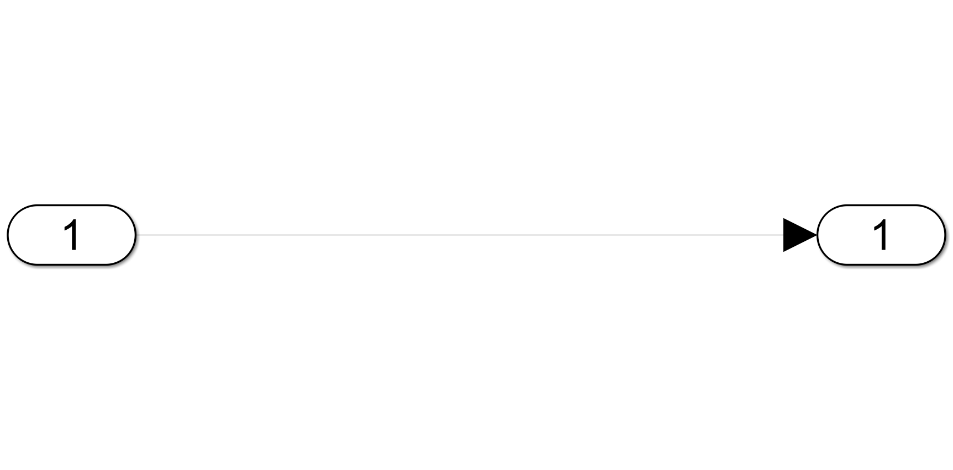
Sensor Modelling
Input
Output

Slide 10
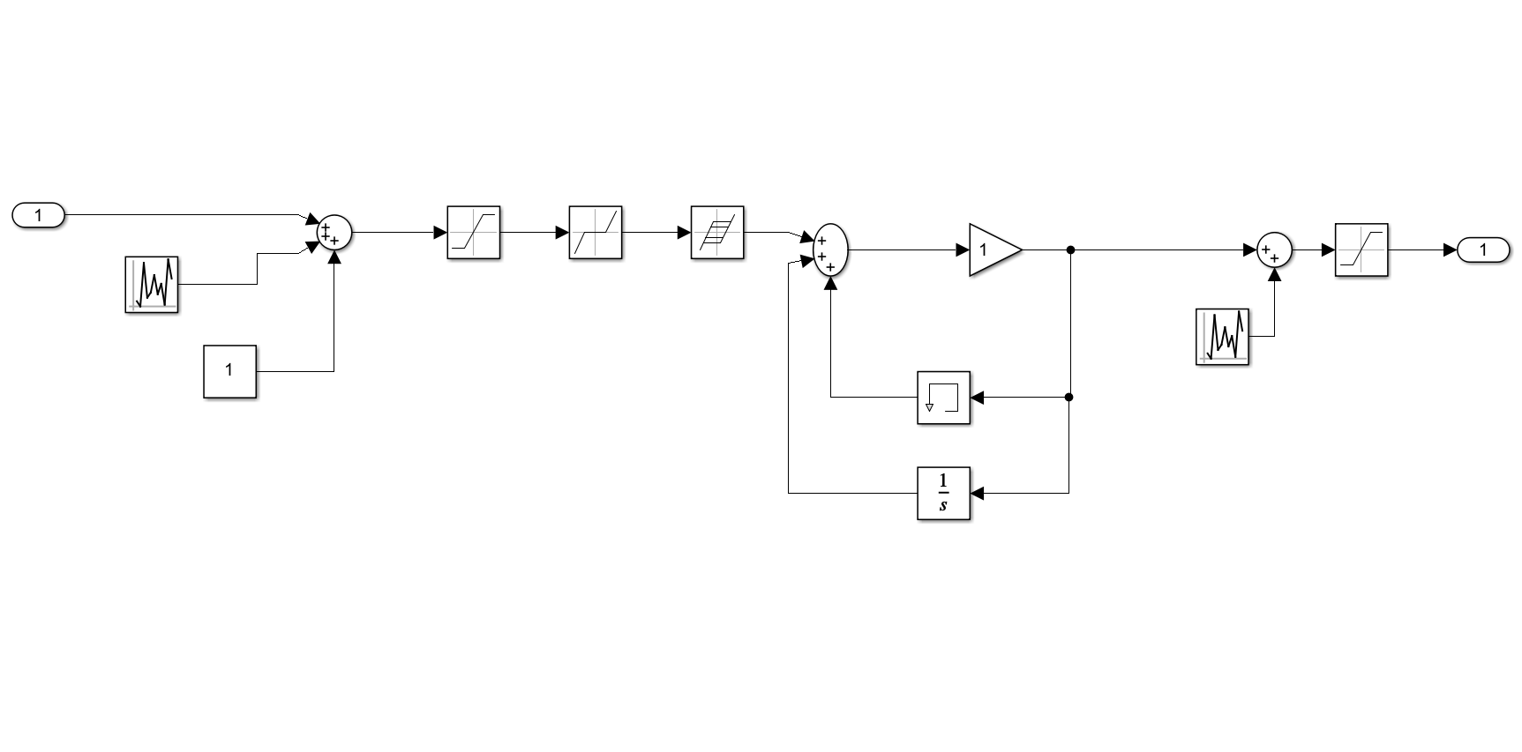
Sensor Modelling
Input
Saturation
Hysteresis
Saturation
Dead band
Output
Noise
Noise
Bias
Previous Measurements
And that’s before you factor in the connection

Slide 11
Example

Slide 12
Temperature Sensor – LMT86
Accurate - ±0.4°C but maximum ±2.7°C
Gain -10.9mv/°C
Range -50°C to 150°C
Thermal time constant 10s (1.2m/s airflow)
Various other but these are the important parameters for us
So what does this mean?

Slide 13
Temperature Sensor – LMT86

Slide 14
Temperature Sensor – LMT86

Slide 15
Temperature Sensor – LMT86

Slide 16
Temperature Sensor – LMT86

Slide 17
Temperature Sensor – LMT86
Conversion of voltage
Output voltage – 2616mV to 420mV (-50°C to 150°C)
Need to detect about 1mV
8 bit AtoD – 256 discreet (assuming 3V reference) 11.7mV… this can be done… but only ever going to get 1°C as a result of the calibration data available in the datasheet.

Slide 18
Examples
Further examples will be made available

Slide 19

Overview
Position and displacement Sensors
Overview
Potentiometers
LVDT
Resolvers

Slide 20
Position and Displacement Sensors

Slide 21
Position and Displacement
Position Sensors Concerned with the determination of the position of some object in relation to some reference point
Displacement Sensors Concerned with the measurement of the amount by which some object has moved
Contact Sensors the object being sensed comes into mechanical contact with the sensor
Non-Contact Sensors there is no physical contact between the object being sensed and the sensor

Slide 22
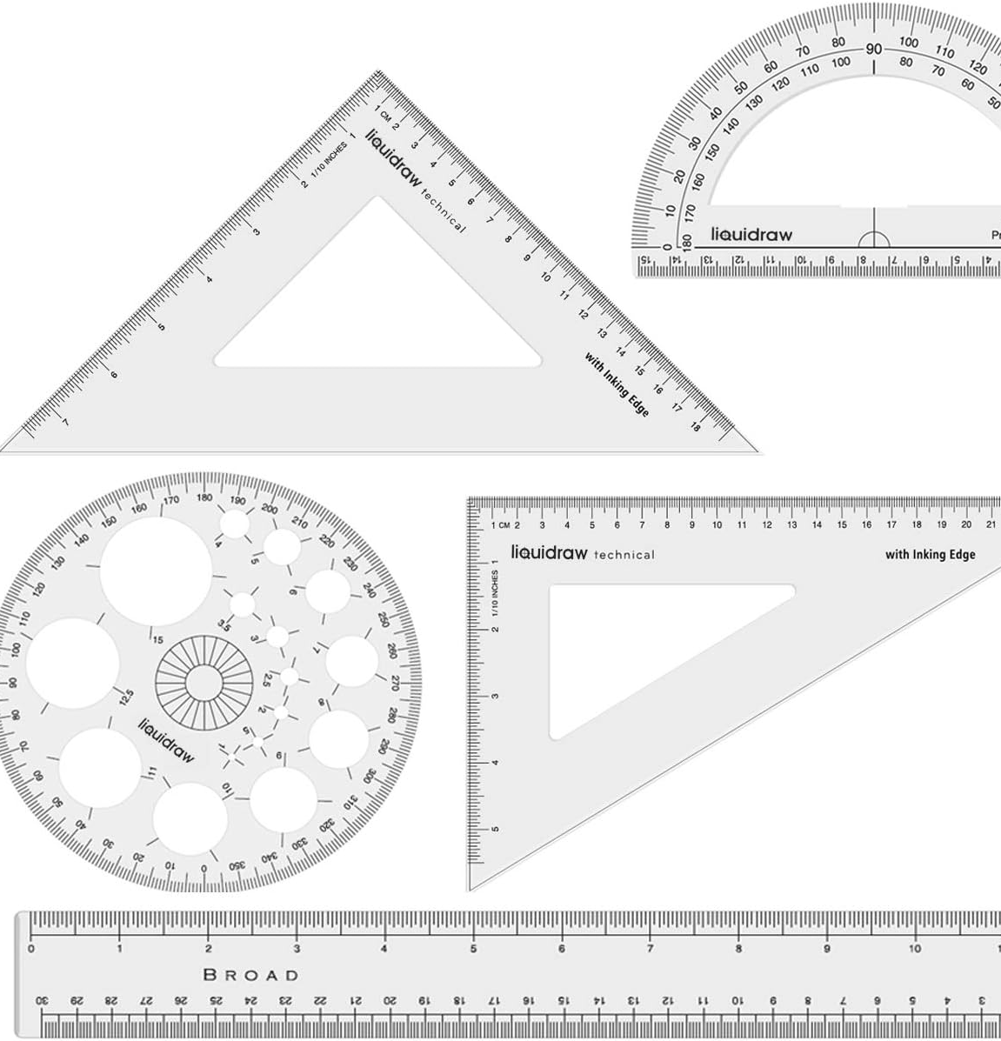
Position and Displacement - Examples
Position
How far from the charging station?
How close is the end effector to the input tray?
Position Sensor
Ruler, protractor
Encoders
Linear and angular variable resistors
Draw string sensors
Displacement
How for has the mobile robot moved?
Displacement sensor
Normally the same devices are used but you are measuring from a different point

Slide 23
Potentiometers

Slide 24
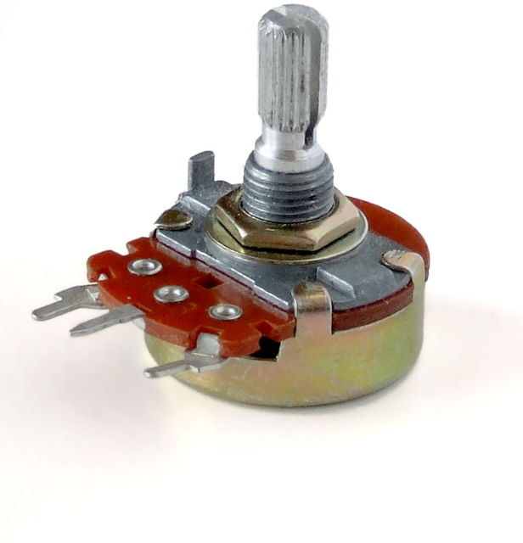
Potentiometers
What can potentiometers be used for?
Provide the position (with suitable calculations) of rotational joints
A potentiometer converts position information into a variable voltage through a resistor
As the sliding contact (wiper) slides along the resistor, the proportion of resistance before or after the wiper contact point varies compared to the total resistance
With a constant input voltage, V_{S}, the output voltage, V_{out}, is a fraction of the input voltage

Slide 25
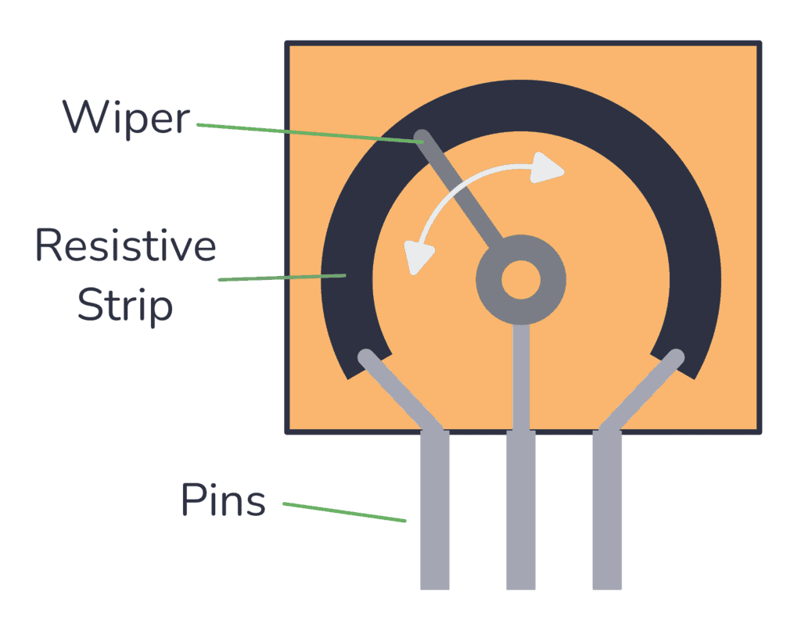
Potentiometers
Potentiometers are available in both linear and rotary forms and can be used to measure linear or angular motion
The resistor is in the form of a track along the potentiometer
This track may be of thin film of a resistive material such as carbon, conductive ceramic, conductive plastic or metal
Alternatively wire wound potentiometers are used with the track consisting of a highly resistive wire wound on to anodised aluminium
https://www.build-electronic-circuits.com/potentiometer/

Slide 26
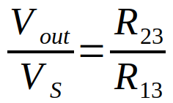
Potentiometers
Input voltage, Vs, is between terminals 1 and 3
Output voltage is between terminals 2 and 3.
With a constant input voltage, V_{S}, the output voltage, V_{out}, is a fraction of the input voltage

Slide 27
Potentiometers
An important effect to be considered with potentiometers is the effect of load, Rl, connected across the output.

Slide 28
Potentiometers
The potential difference across the load, Vl, is only directly proportional to the output voltage, Vout, if the load resistance, Rl, is infinite
For loads of finite resistance, the effect of the load is to transform the linear relationship between voltage and displacement into a non-linear relationship
To find the total resistance across the input voltage we analyse the circuit

Slide 29

Potentiometers
Full Calculation is:
$$\frac{Vl}{Vs}=\frac{x}{\frac{Rp}{Rl}.x.\left(1−x\right)+1}$$
With x being a fraction of Rp
However…

Slide 30

Potentiometers
Error introduced by load having finite resistance is:
$$error=x.Vs−Vl=x.Vs−\frac{x.Vs}{\frac{Rp}{Rl}.x.\left(1−x\right)+1}=Vs.\frac{Rp}{Rl}.\left(x^{2}−x^{3}\right)$$

Slide 31

Potentiometers - Error
Example - 500Ω with slider 1/2 along the track, Rl 10kΩ, Vs 4V
$$error=Vs.\frac{Rp}{Rl}.\left(x^{2}−x^{3}\right)=4×\frac{500}{10000}×\left({0.5}^{2}−{0.5}^{3}\right)=0.025V$$
As a percentage of fullscale input range this 0.625% (0.025/4 * 100)
Example - 500Ω with slider 1/2 along the track, Rl 50kΩ, Vs 4V
$$error=Vs.\frac{Rp}{Rl}.\left(x^{2}−x^{3}\right)=4×\frac{500}{50000}×\left({0.5}^{2}−{0.5}^{3}\right)=0.005V$$
As a percentage of fullscale input range this 0.125% (0.005/4 * 100)
This shows the difference Rl can make.

Slide 32
Potentiometers
Problems with wiper wear are significant and result from the friction between the wiper and track
Reliability improved by minimising current drawn from wiper contact
Provide absolute position information at relatively low cost (unless very high accuracy needed)

Slide 33
Linear Variable Differential Transformer

Slide 34
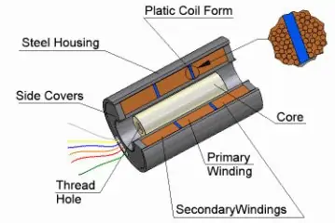
Linear Variable Differential Transformer
LVDT for short
Widely used as primary sensors for monitoring displacements
Consists of three coils symmetrically spaced along an insulated tube.
The central coil is the primary coil and the other two are identical secondary coils which are connected such that their outputs oppose each other.
Measurements made through the movement of a magnetic core which results from the displacement of the probe tip.
https://singer-instruments.com/introduction-to-lvdt/

Slide 35
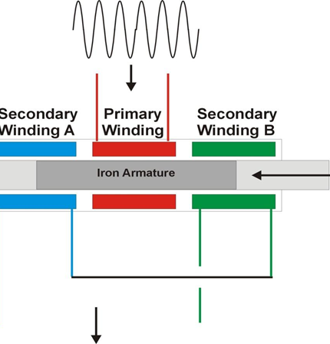
Linear Variable Differential Transformer
When an alternating voltage input is applied to the primary coil, alternating emf′s are induced in the secondary coils
With the magnetic core central, the amount of magnetic material within each of the secondary coils is equal and the emf′s produced in each coil are the same with the net result being zero output
When the core is displaced from the central position, due to probe displacement, there is a greater amount of the core in one of the secondary coils than the other
This results in a greater emf being induced in one coil than the other which produces a non-zero output
The sensor output, the difference between the two emf’s increases with increased displacement
Or… https://www.youtube.com/watch?v=08yKYiZv-kg

Slide 36

Linear Variable Differential Transformer
The emf induced in a secondary coil by a changing current i in the primary coil is given by:
$$emf=M.\frac{di}{dt}$$
M is the mutual inductance which is dependent on the number of turns on the coils and the composition of the core
For a sinusoidal input current of i = isinωt to the primary coil, the emf’s induced in the two secondary coils are:
$$Va=Ka.\sin\left(ω.t−ψ\right) Vb=Kb.\sin\left(ω.t−ψ\right)$$

Slide 37

Linear Variable Differential Transformer
The values of kA, kB and φ depend on the degree of coupling between the primary and secondary coils for a particular core position
φ is the phase difference between the primary alternating voltage and that of the secondary coils
The LVDT is the difference between the two secondary coils given by:
$$Vout=Va−Vb=\left(ka−kb\right).\sin\left(ω.t−ψ\right)$$
When the core is equally in both coils ka = kb and the output voltage is zero

Slide 38

Linear Variable Differential Transformer
When the core is more in secondary coil a than in b we have ka > kb :
$$Vout=\left(ka−kb\right).\sin\left(ω.t−ψ\right)$$
When the core is more in secondary coil b than in a we have ka < kb and there is a phase change of 180:
$$Vout=−\left(ka−kb\right).\sin\left(ω.t−φ\right)$$
or
$$Vout=\left(kb−ka\right).\sin{(ω.t+(ψ−φ\text{))}}$$
The output voltage and phase for varying displacements are shown for the secondary coils in the following slide

Slide 39
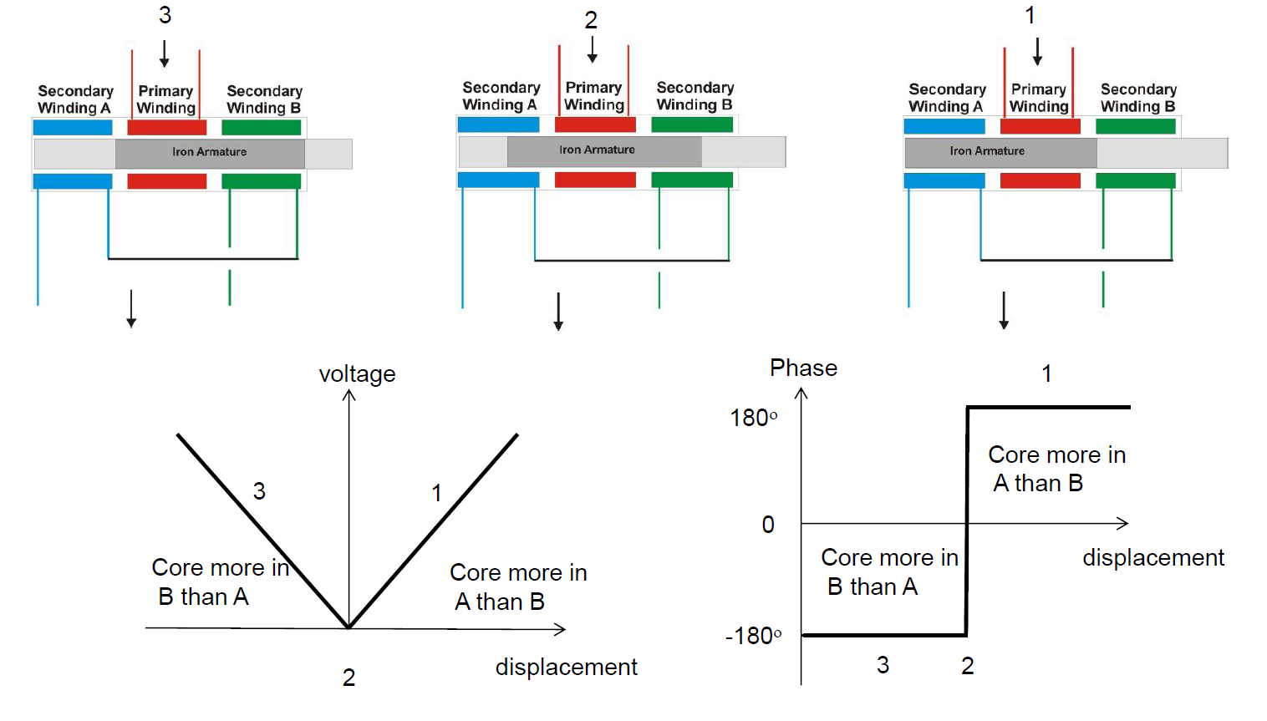
Linear Variable Differential Transformer

Slide 40
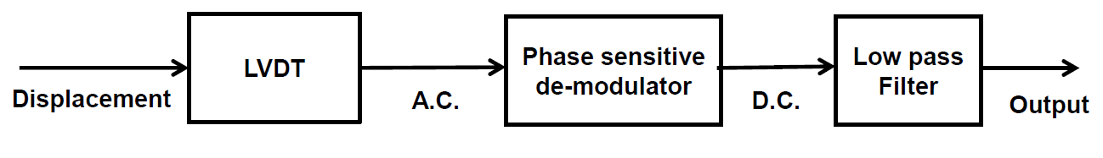
Linear Variable Differential Transformer
With this type of output the same output voltage amplitude is produced for two different displacements
To distinguish between displacements, we need to distinguish them using the phase of their output voltage
A phase sensitive demodulator, with a low pass filter, is used to convert the output into d.c. voltage which gives a unique value for each displacement

Slide 41
Linear Variable Differential Transformer
LVDTs are rugged devices compared to potentiometers and can be used as secondary sensors for the measurement of Force, Weight or Pressure.
They have operating ranges between ±2 to ±400mm with non-linearity errors of around ±0.25%
They are also very accurate, with accuracies from 0.5% to 0.05% typically, but require external support circuitry
Resolution limited by presence of the null voltage (exact cancellation of secondary voltages not possible due to different phase shifts in the two windings).

Slide 42
Resolver

Slide 43
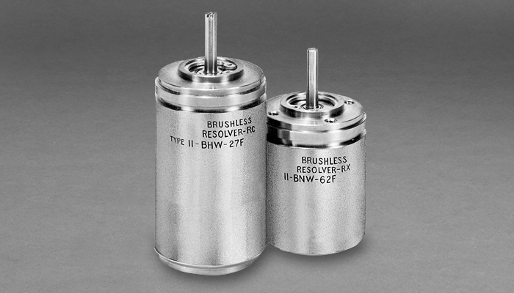
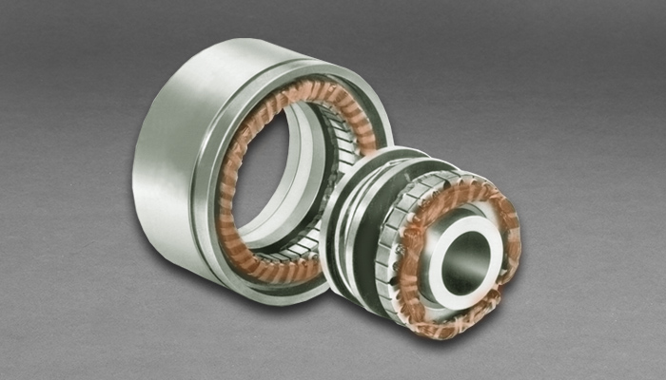
Resolvers
Resolvers are like LVDTs in principle but are used to measure angular motion
A resolver is also a transformer where the primary coil is attached to the rotating shaft and carries an alternating current, either through slip rings or from a brush-less transformer within it
There are two secondary coils positioned 90° apart from each other
As the rotor rotates the flux it develops rotates with it

Slide 44
Resolvers
When the primary coil is parallel to either of the secondary coils the voltage induced in the coils is maximum

Slide 45
Resolvers
At this instant the primary coil is perpendicular to the other secondary coil and no voltage is developed within it
As the primary coil rotates the voltage in the first secondary coil goes to zero whilst the voltage of the other secondary coil becomes maximum
For all angles in between the two secondary coils develop a voltage proportional to the sine and cosine of the angle between the primary and secondary coils
Resolvers are reliable, robust and accurate
Accuracy more dependant on the sensing circuitary
However, resolvers are significantly more expensive than potentiometers
High speeds up to 20000RPM

Slide 46
Review
Overview
Potentiometers
LVDT
Resolvers

Slide 47
References
Bolton, W., Mechatronics, 5th Edition, Pearson, 2012
Chapter 2 - Sections 2.1 and 2.2
Niku, S.B. , Introduction to Robotics, 2nd Edition, Wiley, New Jersey, 2011.

